Slide 1


COME DIAGNOSTICARE IL GERD DOPO CHIRURGIA
Prof PAOLA IOVINO
Gastroenterologia
Università di Salerno

Slide 2
Disclosure of Conflicts of Interest
I herewith declare the following paid or unpaid consultancies, business interests or sources of honoraria payments for the past three years, and anything else which could potentially be viewed as a conflict of interest:
Aboca, Alfasigma, Norgine, Dr Falk.

Slide 3
Preoperative assessment of GERD symptoms and HH
Bariatric Surgery
Recurrence/worsening of GERD symptoms
New onset of GERD symptoms
Worsening of QoL
Negatively affect weight loss prognosis
Expose the pts to the sequelae of GERD
Angrisani L et al.SOARD 2015

Slide 4
KEY POINTS
Preoperative GERD diagnosis with its variables
Intraoperative HH diagnosis
Hiatal hernia repair and choice of the proper operation
recurrence of GERD symptoms or their new-onset after surgery

Slide 5

1° STEP AFTER SURGERY
CLINICAL EVALUATION

Slide 6
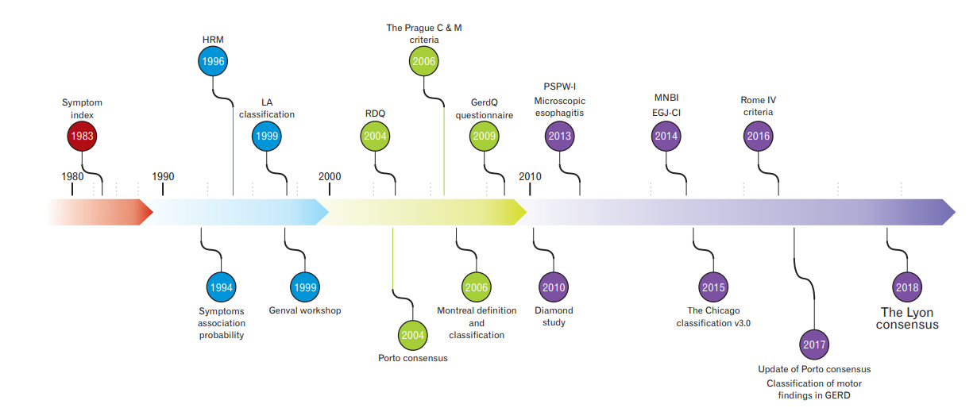
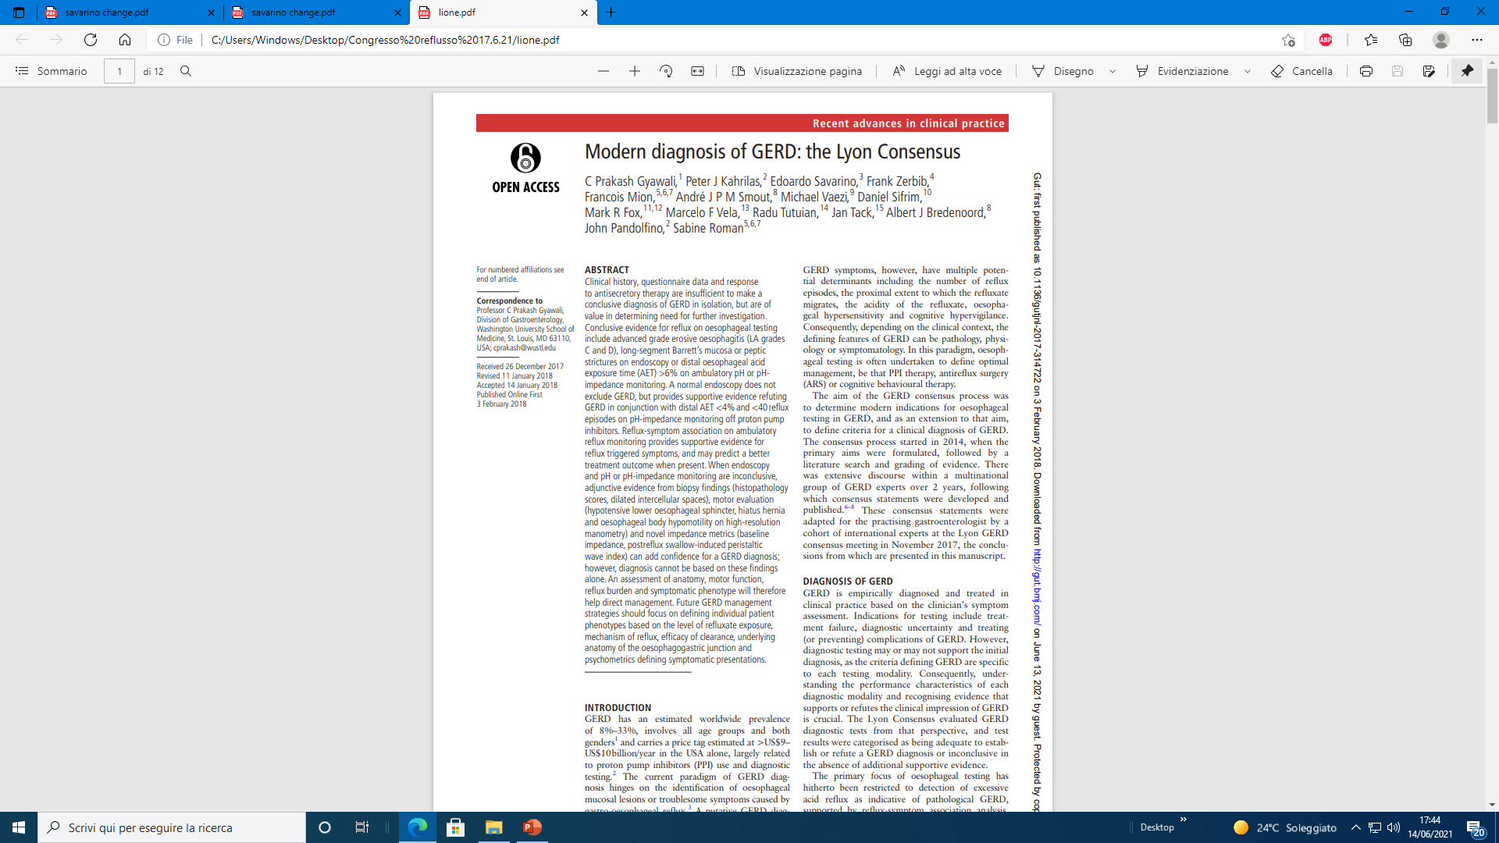
GERD OR NOT????
The label “GERD” started to be associated with a long list of signs and symptoms, sometimes without proven evidences, resulting in frequent misdiagnosis and misuse of medical therapies.
Therefore, it has become more and more important to diagnose or to exclude GERD with enough confidence.
Ghisa M. et al.Neurogastroenterol Motil. 2020
Gyawali CP, et al. Gut 2018

Slide 7

DIAGNOSTIC PITFALLS
Expert history by a gastroenterologist 70% sensitivity 67% specificity
(when compared with objective evidence of GERD defined by pH-metry)
GERD questionnaires: accuracy less than 70%
MONTREAL CONSENSUS
Ghisa M. et al. J Neurogastroenterol Motil. 2020
Notes:
Dent J, Vakil N, Jones R, et al. Accuracy of the diagnosis of GORD by questionnaire, physicians and a trial of proton pump inhibitor treatment: the diamond study. Gut 2010;59:714-721.
Bolier EA, Kessing BF, Smout AJ, Bredenoord AJ. Systematic review: questionnaires for assessment of gastroesophageal reflux disease. Dis Esophagus 2015;28:105-120.

Slide 8
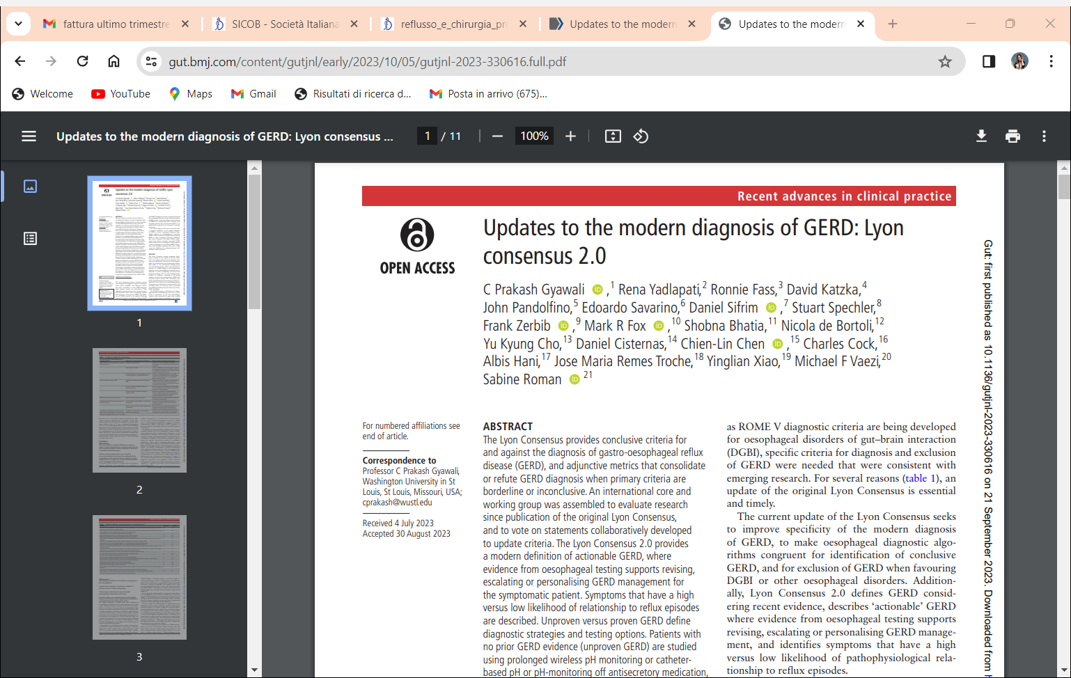
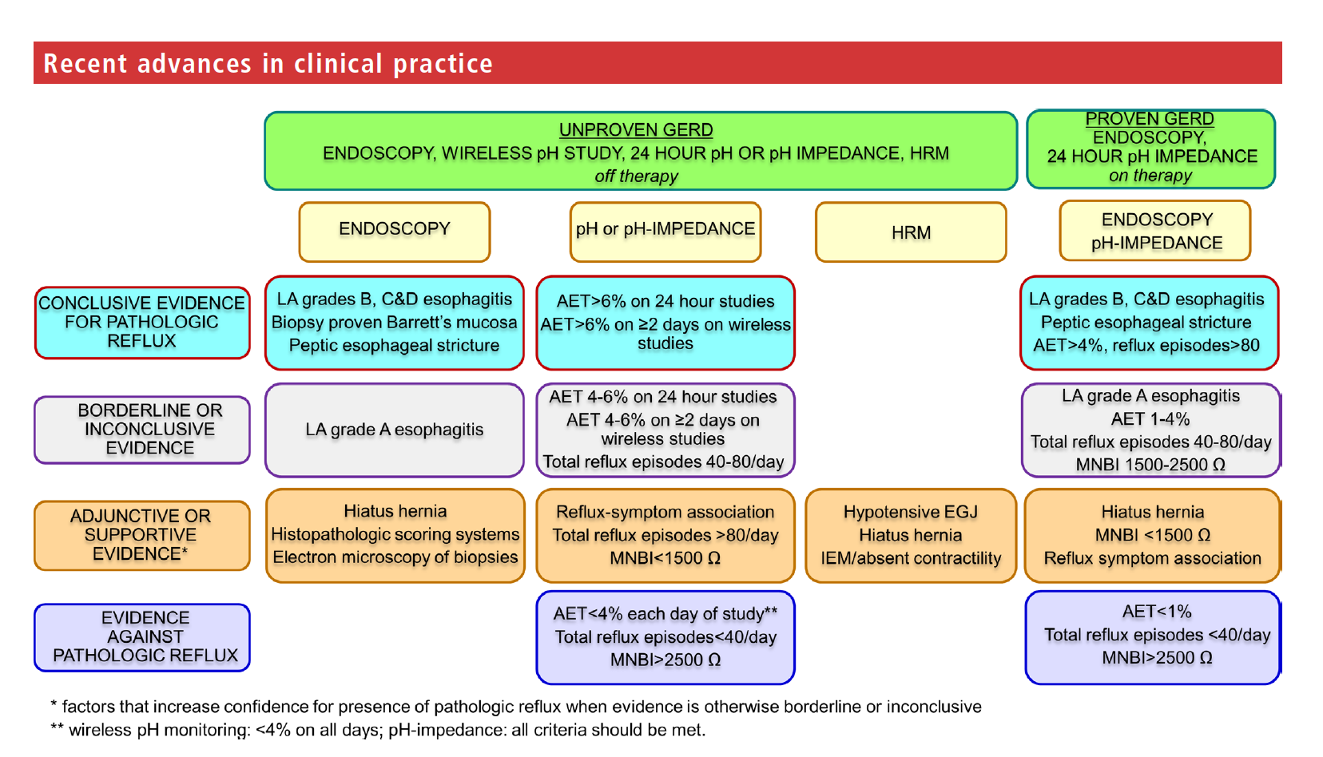
Gyawali CP, et al. Gut 2024

Slide 9
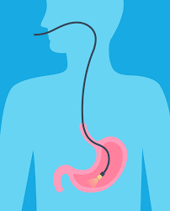
2° STEP AFTER SURGERY
ENDOSCOPIC EVALUATION

Slide 10
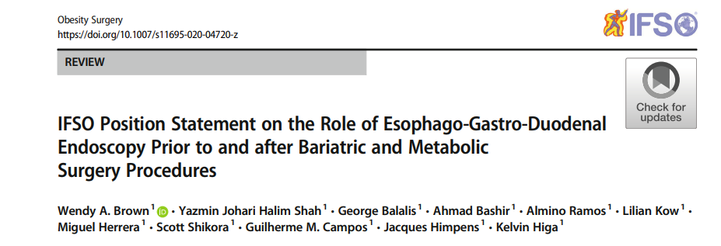
EGD should be undertaken routinely for all patients after bariatric surgery at 1 year and then every 2– 3 years for patients who have undergone LSG or OAGB to enable early detection of Barrett’s esophagus or upper GI malignancy until more data is available to confirm the incidence of these cancers in practice.
EGD should be performed following AGB and RYGB on the basis of upper GI symptoms
2020
Sugano et al.
Gut, 2022

Slide 11
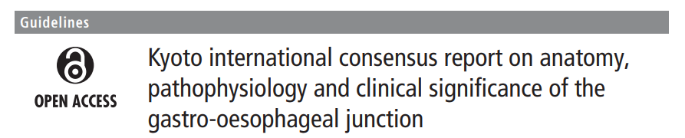
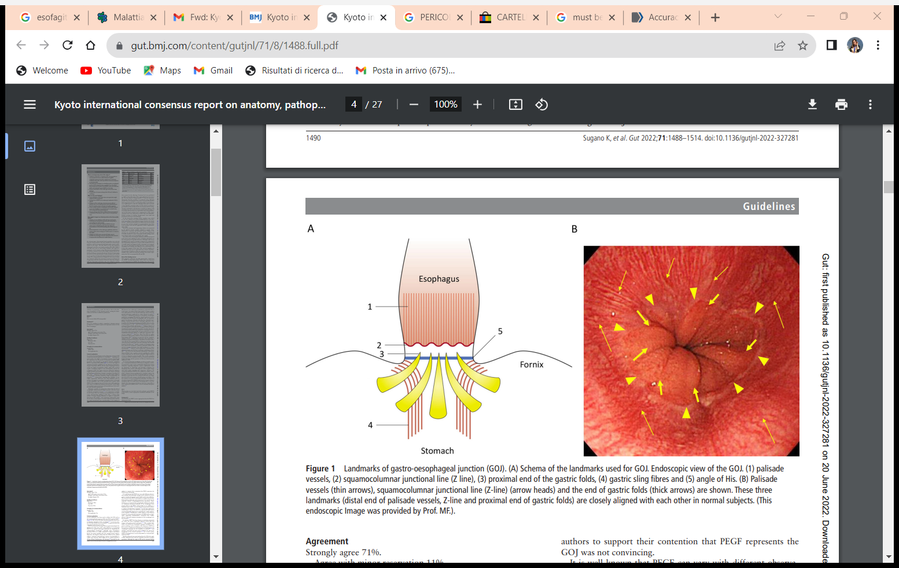
Sugano K, et al. Gut 2022;71:1488–1514. doi:10.1136/gutjnl-2022-327281
Sugano et al.
Gut, 2022

Slide 12
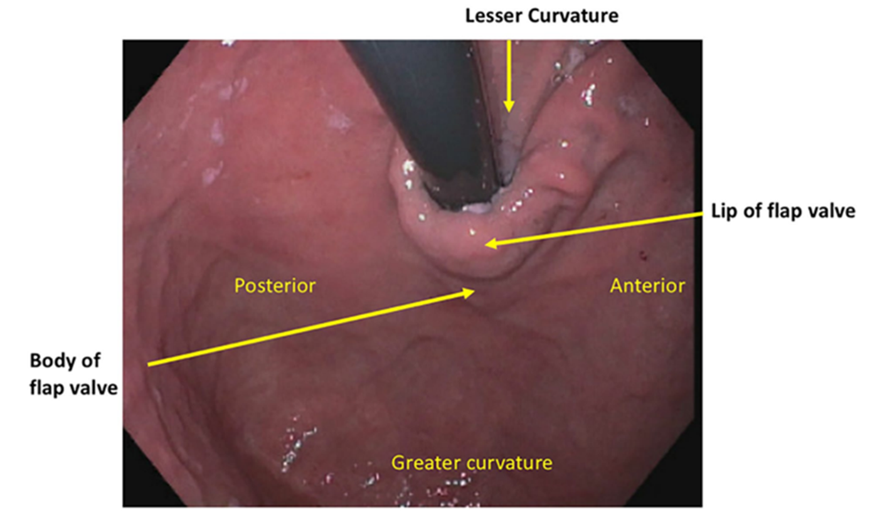
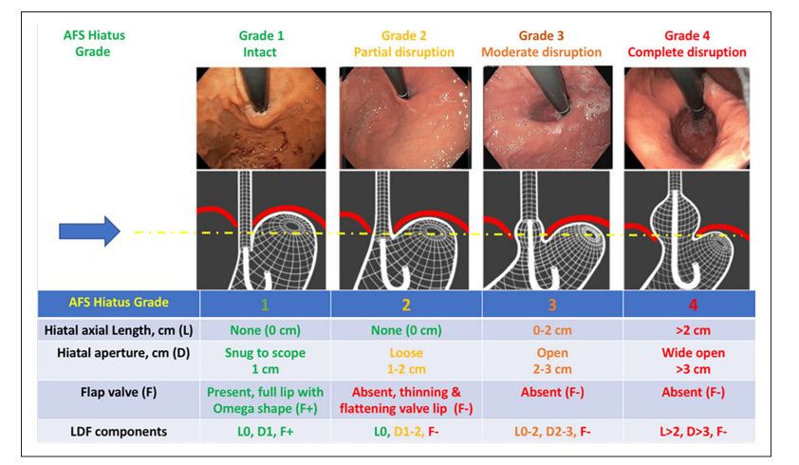
LDF components: hiatal axial length; hiatal aperture measured in centimeters; and the present or absent of a functioning flap valve.
Nguyen et al, 2022

Slide 13
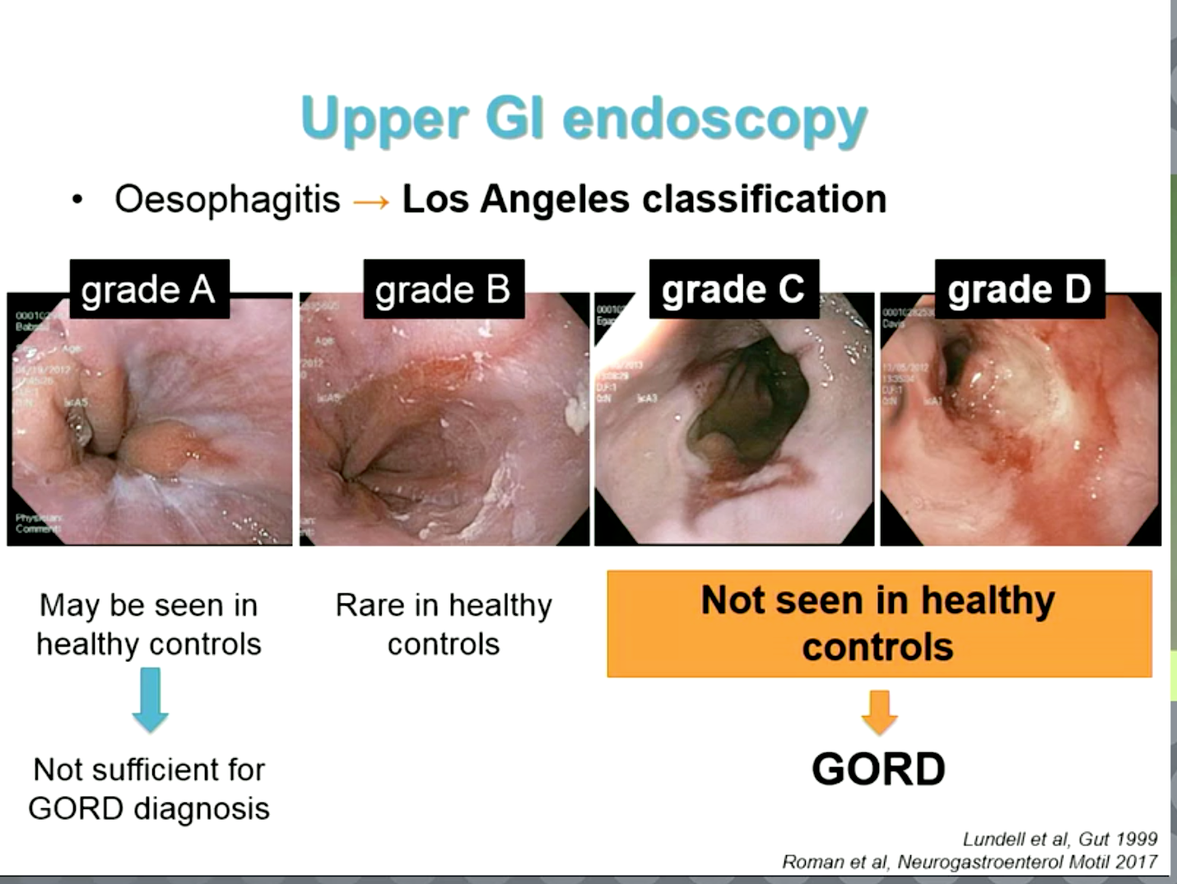
LOS ANGELES CLASSIFICATION
LYON
CONSENSUS
1994
1996
1999
2008
2017
WCG in LA
Armstrong et al
Lundell
et al
Bredenoord et al
Roman
et al
~ 30%
No erosive esophagitis

Slide 14

3° STEP AFTER SURGERY
RADIOLOGICAL EVALUATION

Slide 15
Obesity Surgery, 2021
The presence of ITSM indicated more frequent GERD symptoms and a higher probability of suboptimal weight loss.

Slide 16
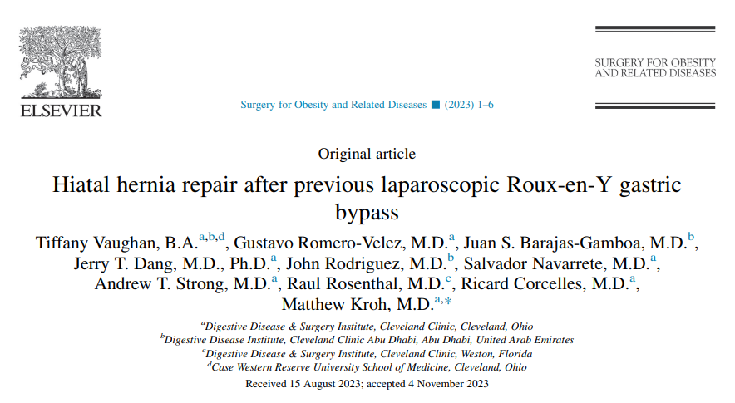
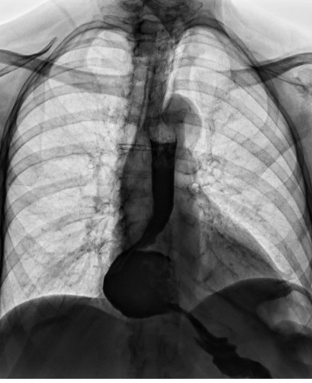
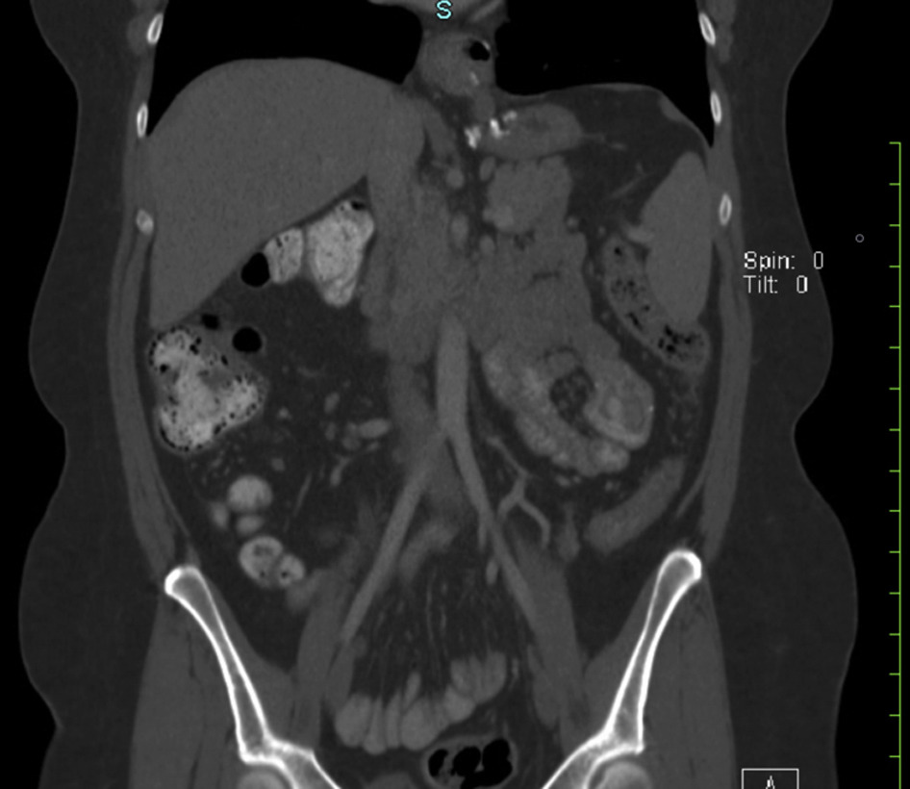
SOARD 2020

Slide 17
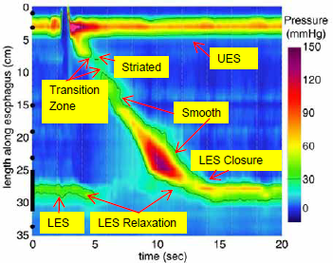
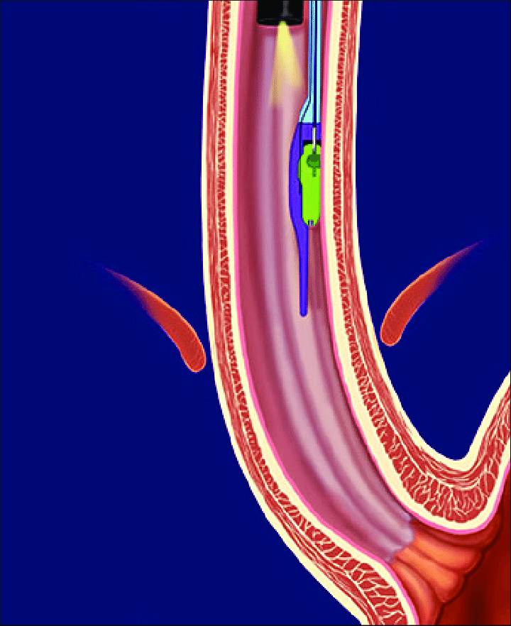
4° STEP AFTER SURGERY
MOTILITY TESTS

Slide 18
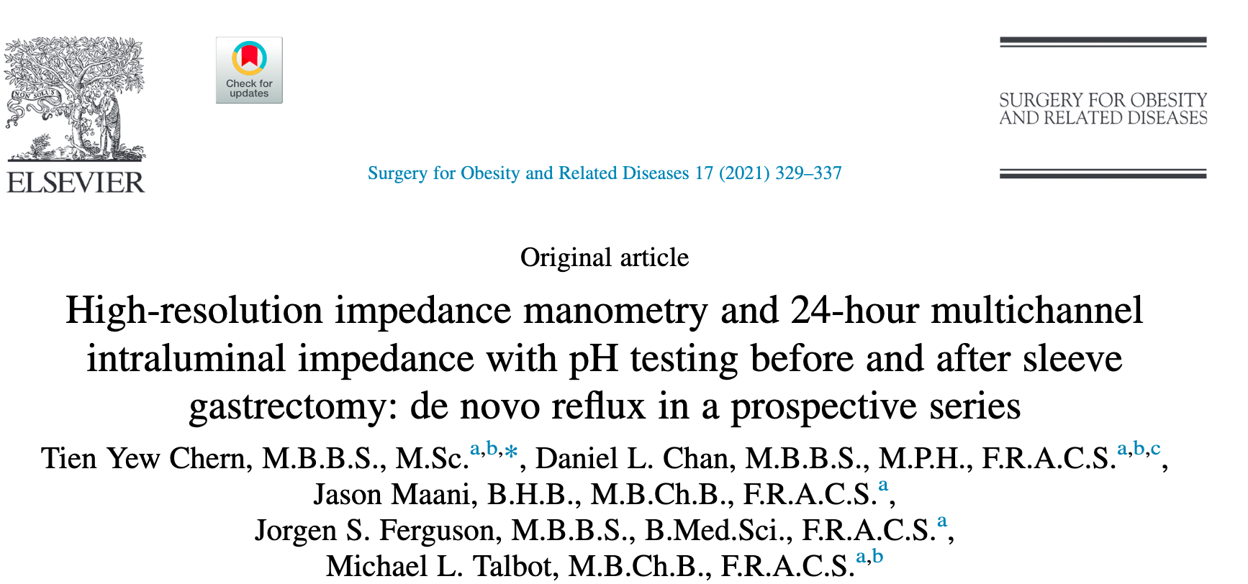
HRM, 24-hour MII-pH, and Gastroesophageal Reflux Disease Symptom Assessment Scale (GSAS) questionnaire
1 month before and 6 months after SG.
31 PTS
HRM demonstrated significantly increased intragastric pressures (15.5–29.6 mm Hg) and failed swallows (3.1–7.5%) but no other change in esophageal motility.
MII-pH did not demonstrate significant changes in acid exposure time (8.5%–7.5%) or number of reflux episodes, although the numbers of long reflux episodes Q1 (2.3–4.7) and weak acid reflux episodes were significantly increased (15.4–55.2).
DeMeester and GSAS scores were not significantly changed. There was no significant difference in patients with preexisting reflux.
However, for patients without preexisting reflux, acid exposure time increased significantly (1.3%–6.7%), as did DeMeester Q2 scores (5.8–24.5) and the numbers of long reflux episodes (.1–4.4) and weakly acidic episodes (22.1–89.2).

Slide 19
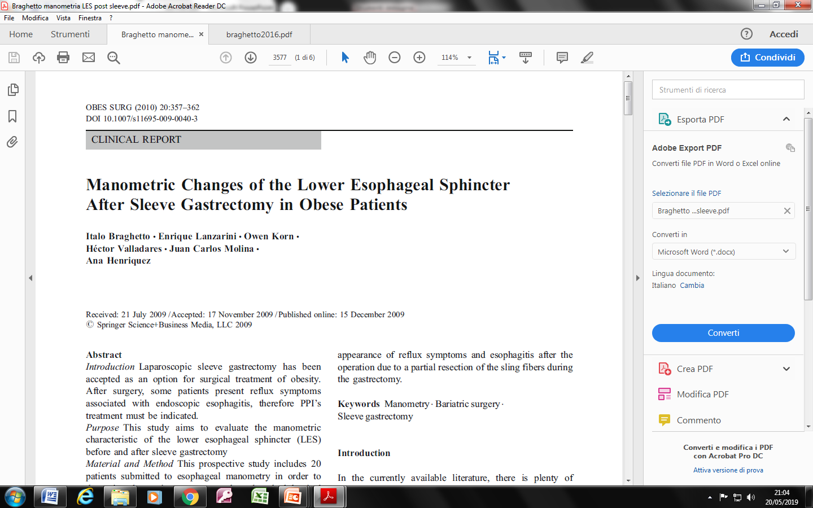
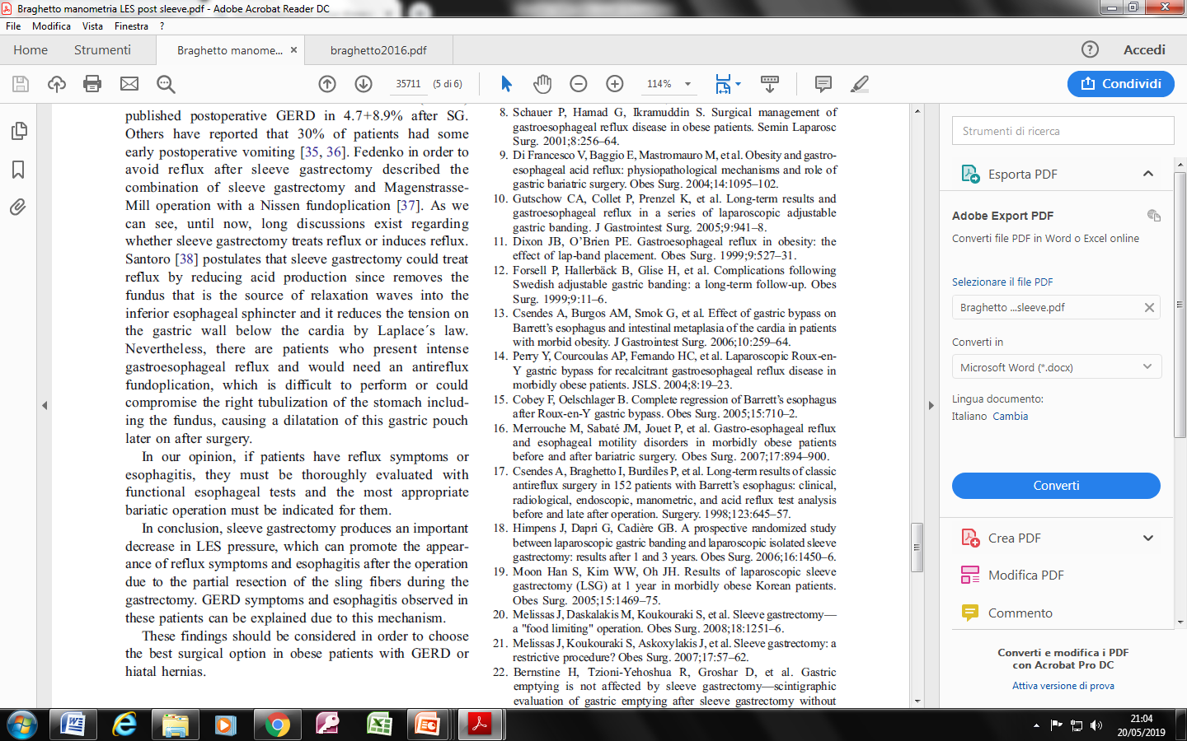

Slide 20
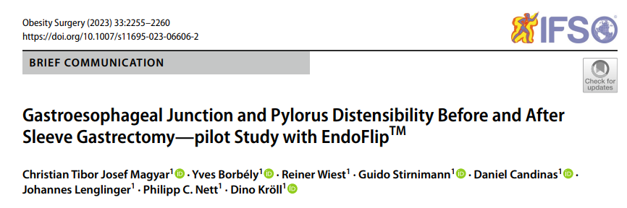
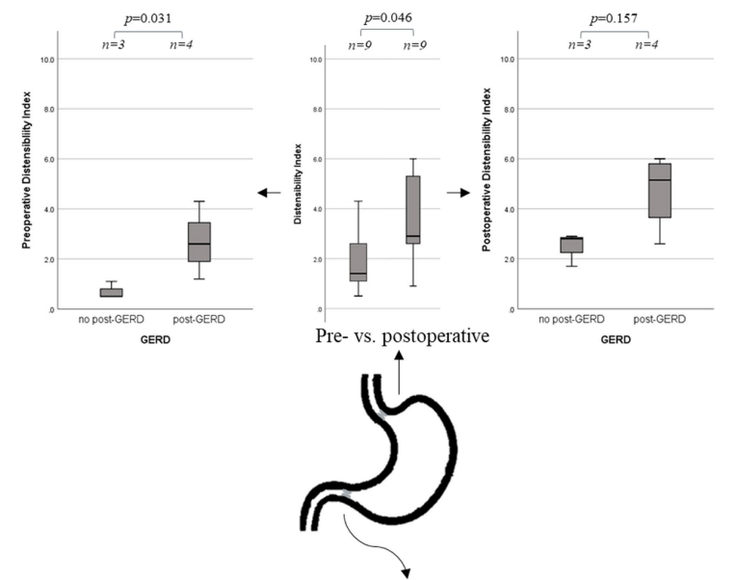
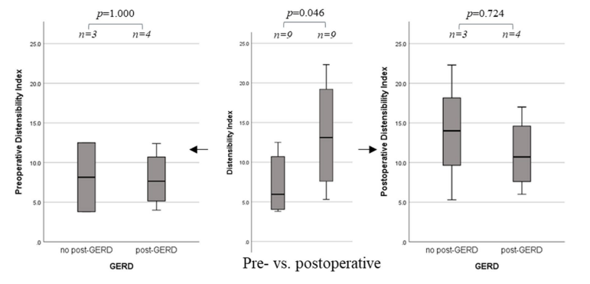

Slide 21
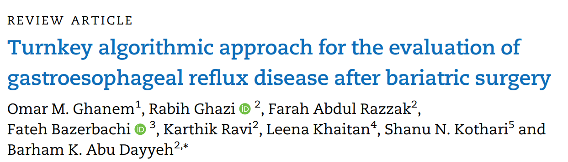
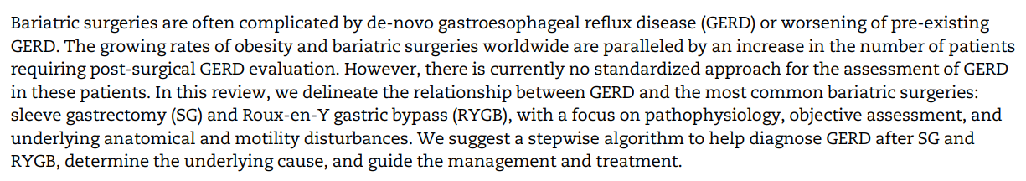
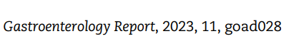

Slide 22
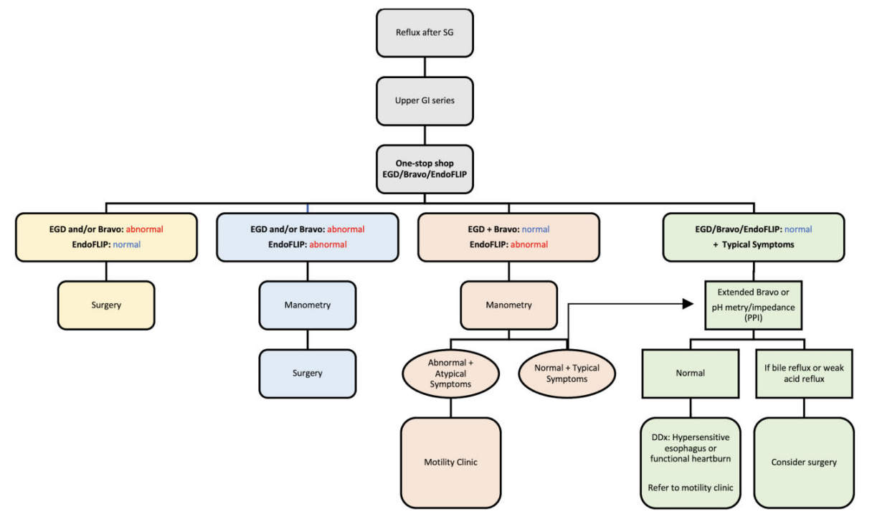
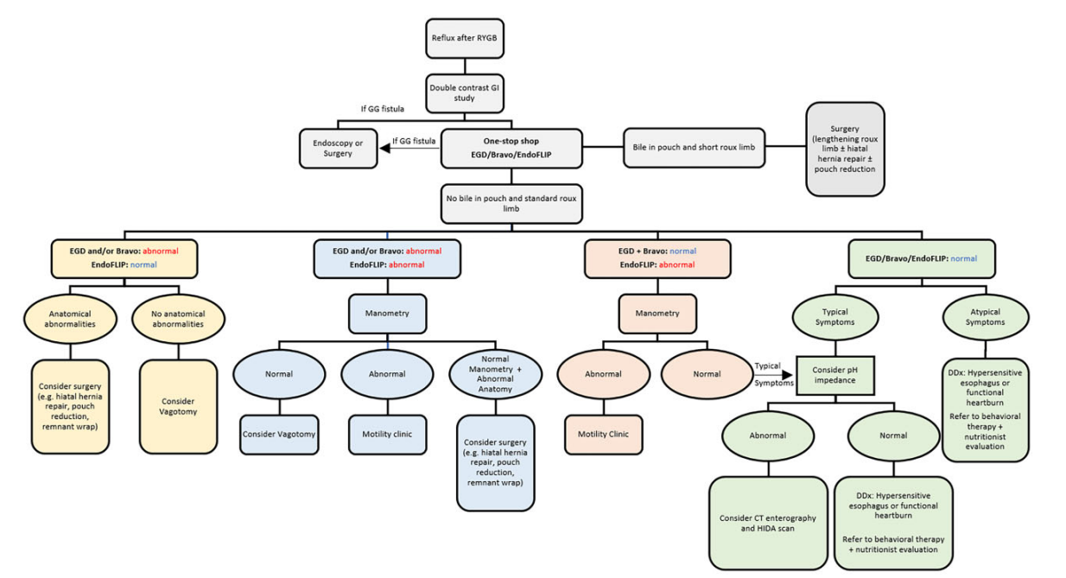
Evaluation of reflux in
patients with SG
Evaluation of reflux in
patients with RYGB

Slide 23
CONCLUSIONS
The growing rate of obesity worldwide is expected to yield a simultaneous increase in bariatric surgeries, and consequently an increase in the number of patients requiring evaluation of GERD after surgery.
An accurate post-surgical evaluation in a patient with new-onset or refractory reflux is warranted to improve the patient’s quality of life and mitigate the sequelae of GERD, including erosive esophagitis, Barrett’s esophagus, and esophageal adenocarcinoma
Several tools are used to objectively evaluate and diagnose GERD after bariatric surgeries. These include esophagogastroduodenoscopy (EGD), pH studies, high-resolution manometry (HRM), and the Endoluminal Functional Lumen Imaging Probe (EndoFLIP)
However, there is no standardized approach for the assessment of GERD in these patients

Slide 24
Grazie

